Slide 1
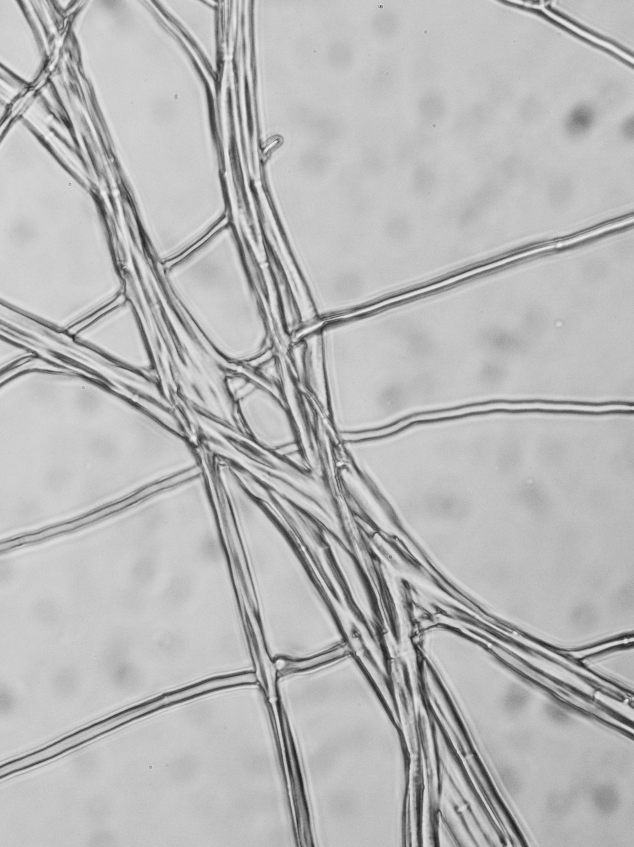
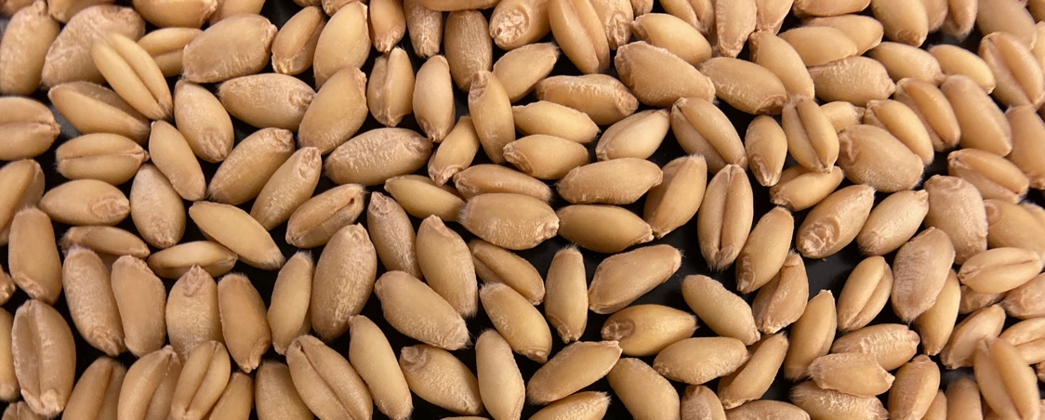
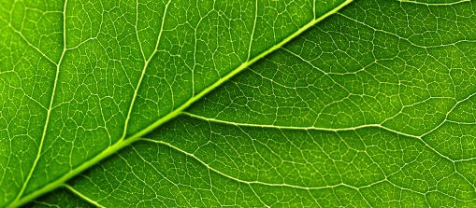
All About Microbes That Live Inside Of Plants

Slide 2
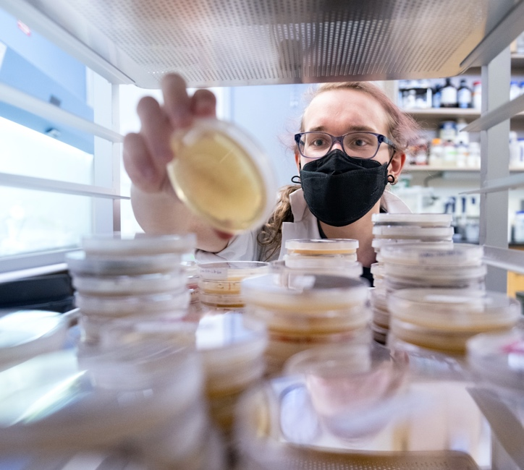
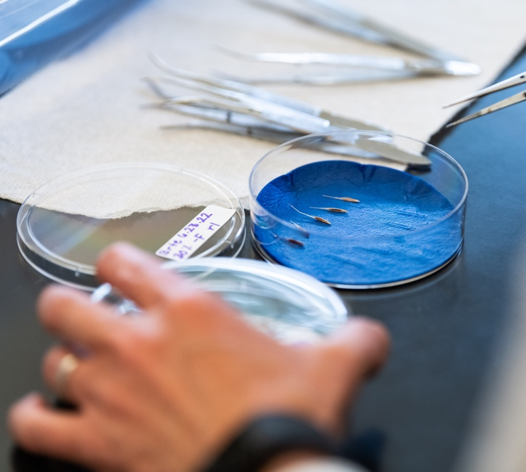
Do microbes help or hinder plants?
Do microbes help or hinder plants?
What do you think?
What do you think?

Slide 3
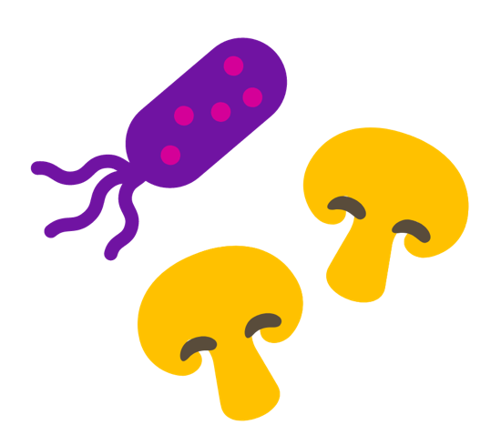
Bacteria:
Stimulate plant and seed growth
Help plants to survive cold
Help
Positive interaction between plants and microbes
--Mutualism
Fungi:
Help plants survive drought
Enable plants to grow in soils post wildfire

Slide 4
Bacteria:
Cause roots to die and rot
Simulate overgrowth of some plant tissues (like cancer)
Hinder
Negative interaction between plants and microbes
--Pathogens
Fungi:
Restrict water uptake in seedlings
Eliminate seed production on plants

Slide 5
Sometimes microbes do neither
--Commensalisms
--or the relationship is unknown
And Sometimes the relationship shifts:
Example…
  No impact at seed stage but positive at later life stage

Slide 6
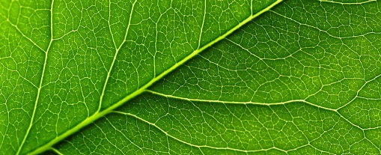
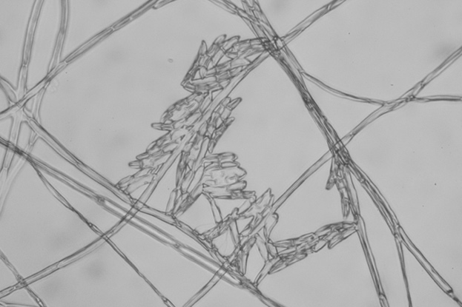
Fun-guy to be with
Microbes that live within the tissues of plants are called Endophytes
Endo = within
Phytes = plants
Plant provides a place for the endophytes to live
Endophytes often benefit the plant, but some can turn into pathogens

Slide 7

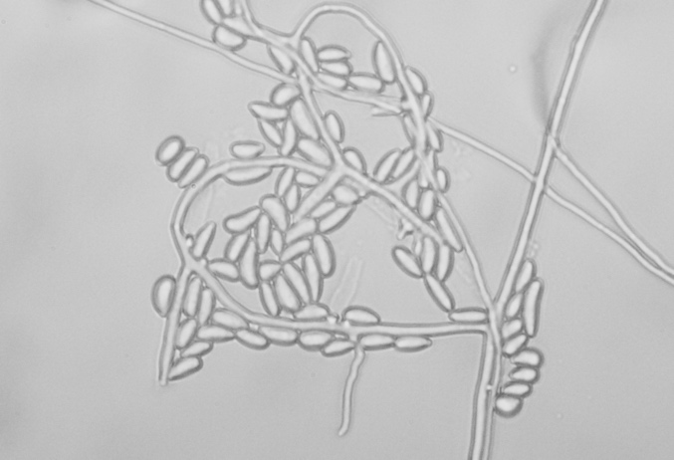
I love to hang with seeds
Reduce the number of days to germinate and benefit the seed
BUT pathogens can interfere with germination progress
Endophytes (the good and the bad) also interact with each other
Endophytes Can Help Seeds To Germinate

Slide 8


How To Play
Glorious Germination

Slide 9
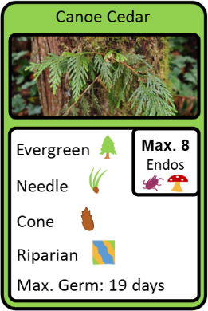
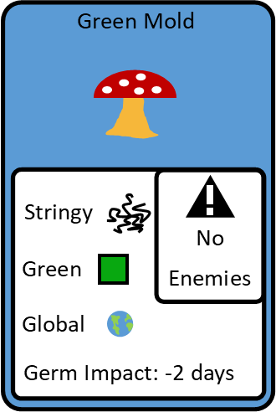

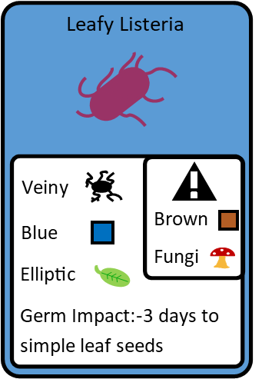
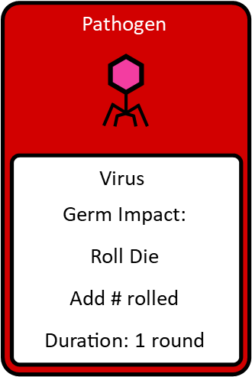

Playing The Card Game
Formula 1 Race Car
YouTube Video
How to play
(5 minutes): https://www.youtube.com/watch?v=gUXCDYw8F4E

Slide 10
Wrap Up

Slide 11
Do microbes help or hinder plants?
What do you think?

Slide 12
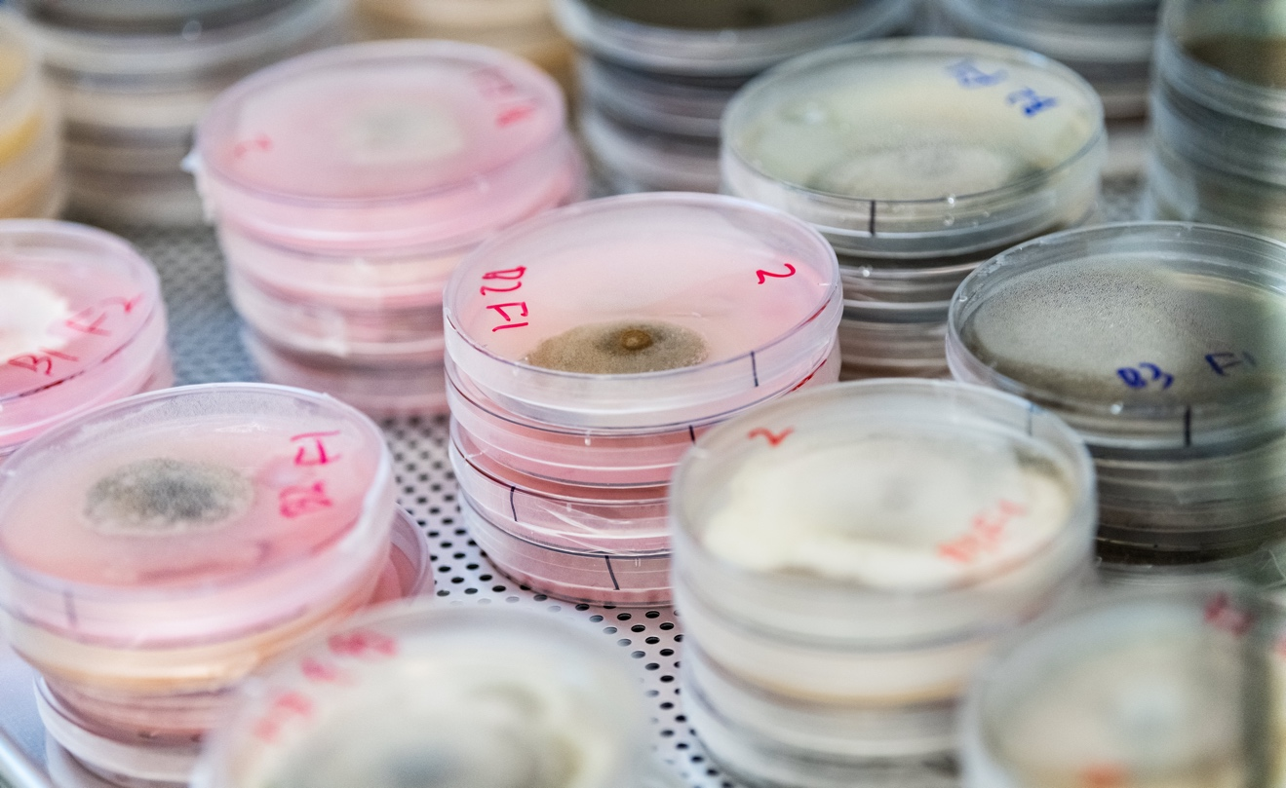
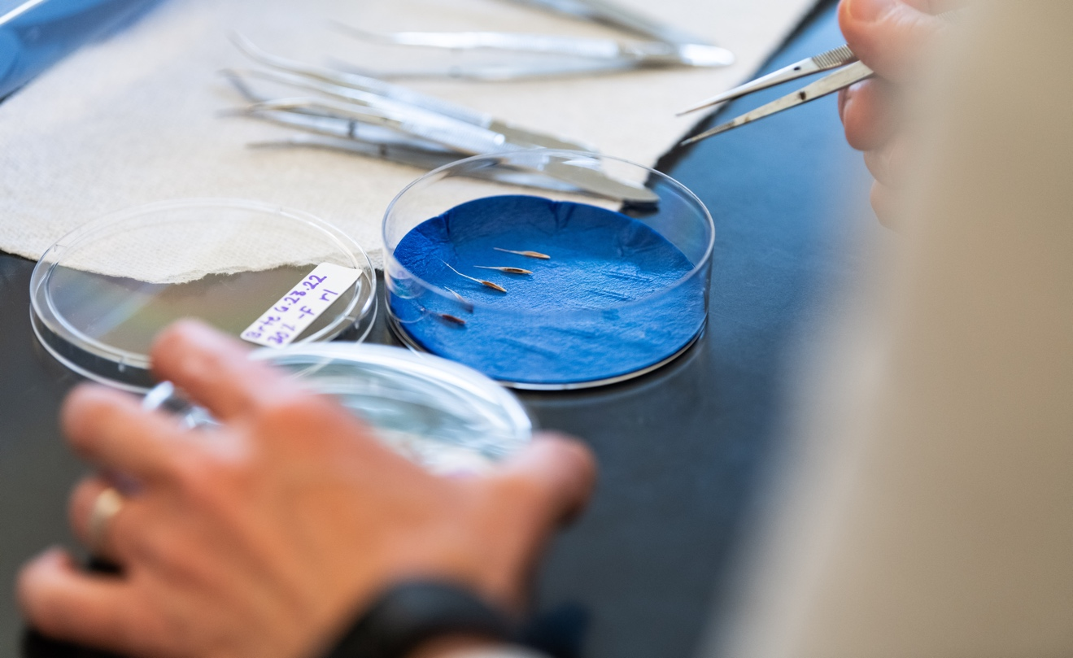
Do Microbes Help or Hinder Germination?
Can endophytes help solve problems today?
What did you learn about pathogens?

Slide 13
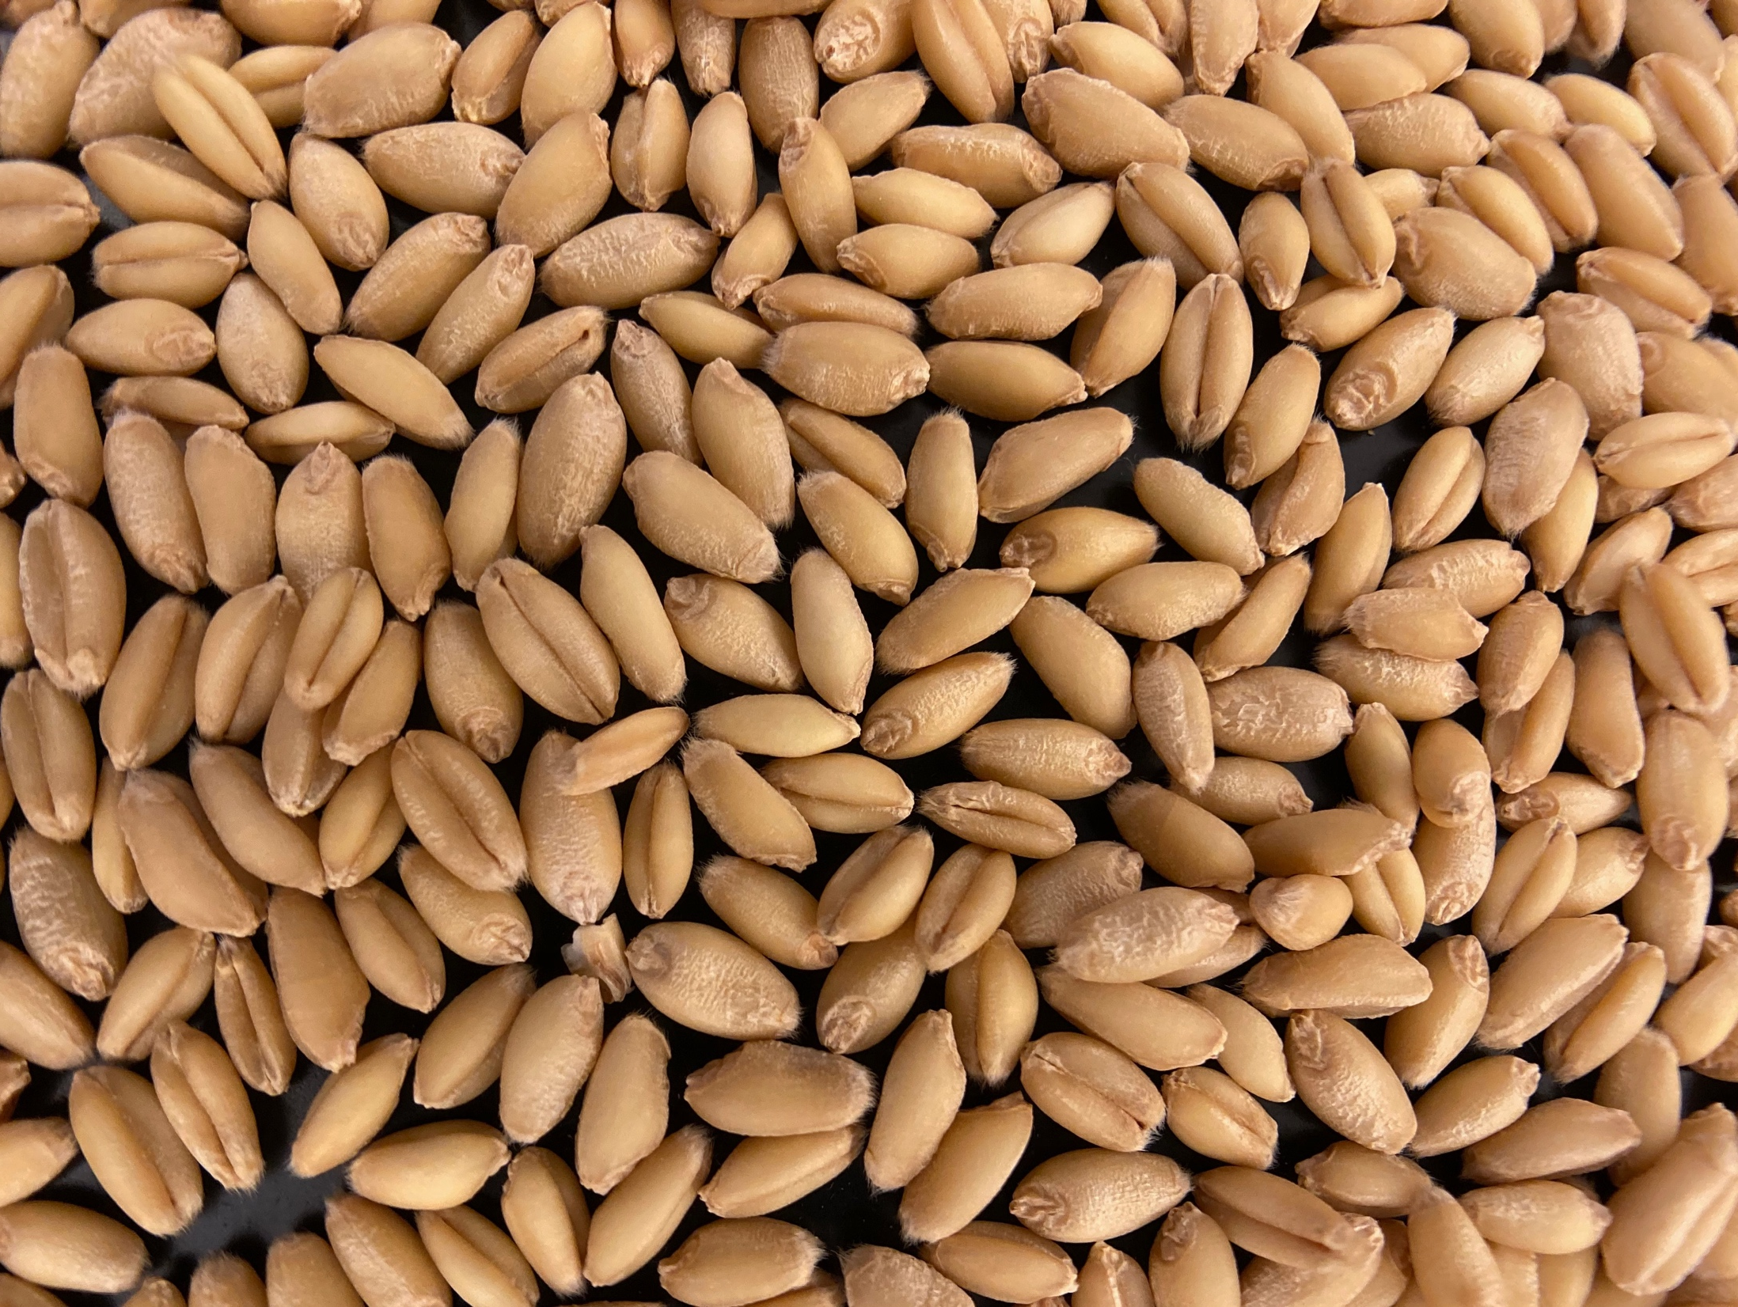
All About
Seeds For The Future

Slide 14
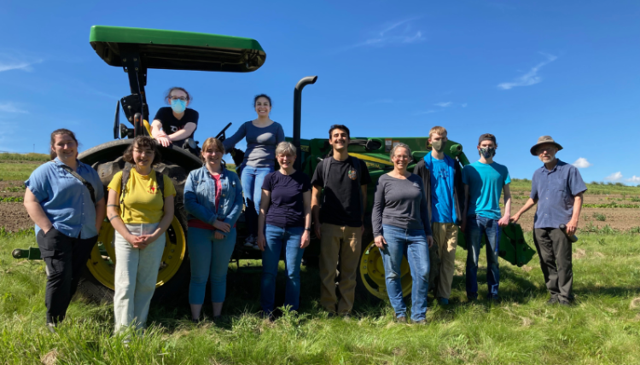
Exploring seed-microbe applications for natural resources and agriculture

Slide 15
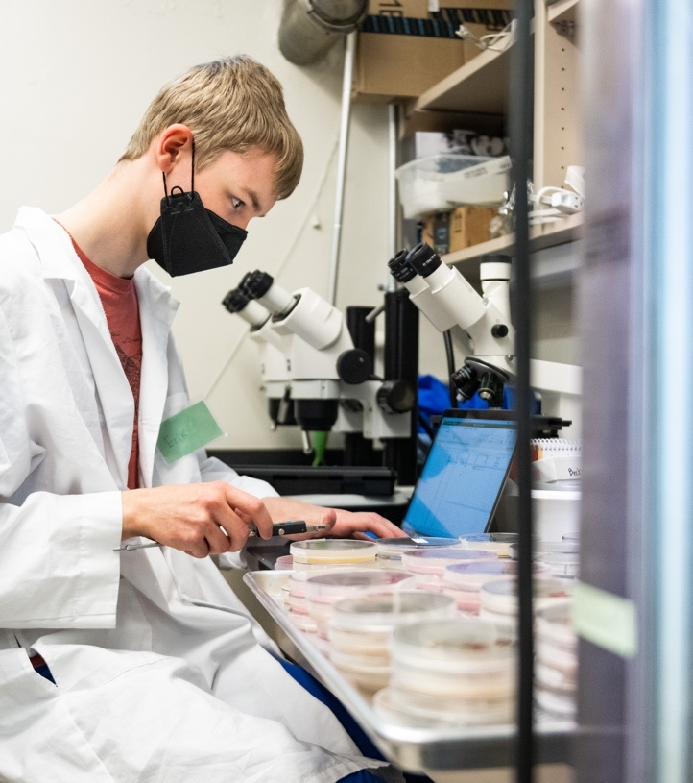
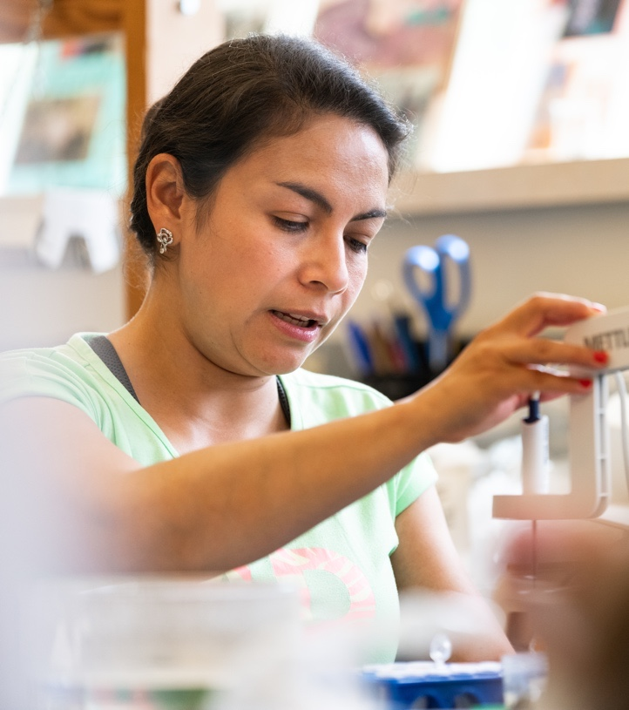
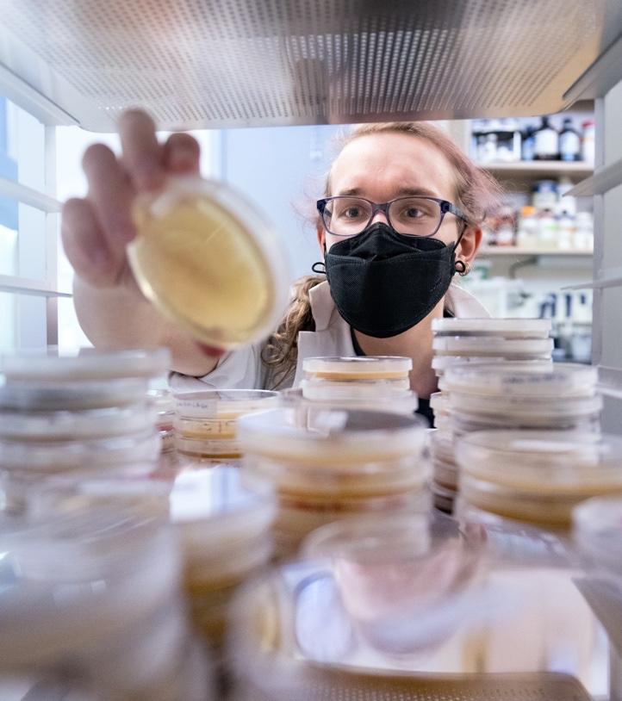
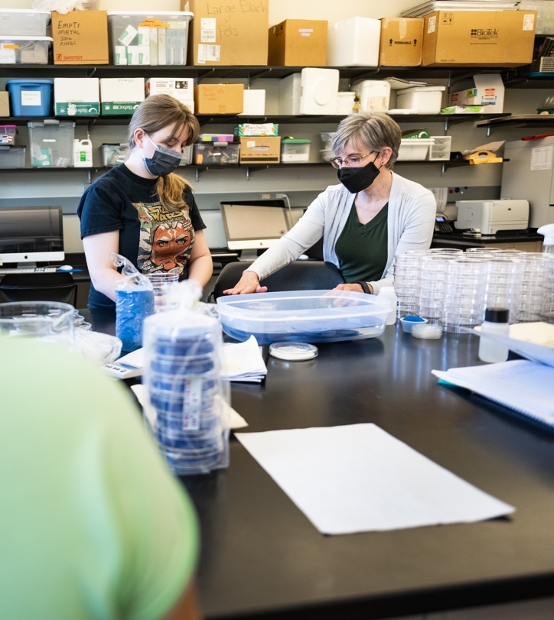
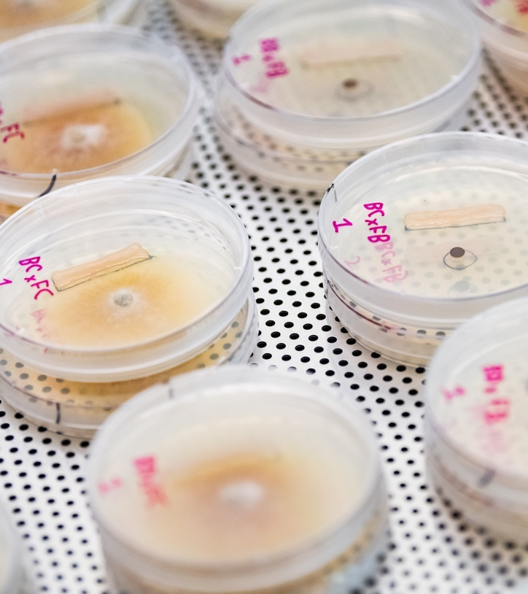
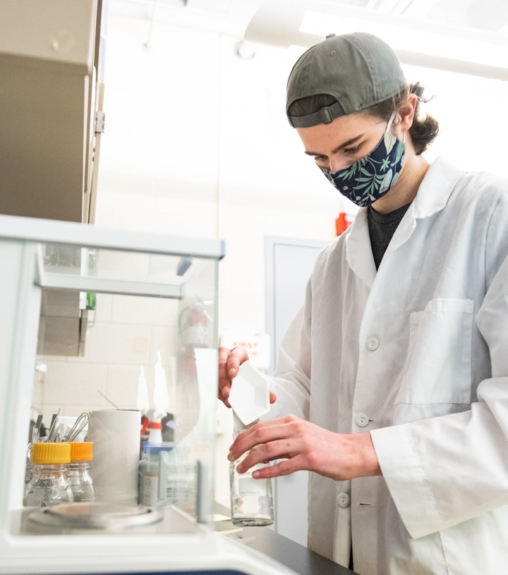

What kind of careers are associated with this game activity?

Slide 16
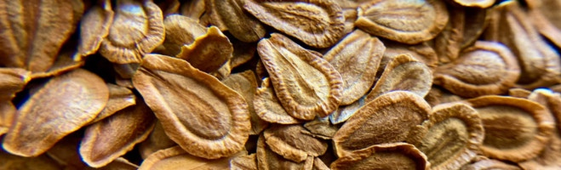
Summer 2022 – Research Projects
Effects of Abiotic Stressors on Germination and Seedling Growth of Native Yarrow and Invasive Cheatgrass
Germination and Electrolytes Leakage on Seeds After Heat and Freeze Abiotic Stressors
The Antagonistic Effects of Seed Endophytes
The Effect of Bacteria Media on Seed Germination of Native Plant Species

Slide 17
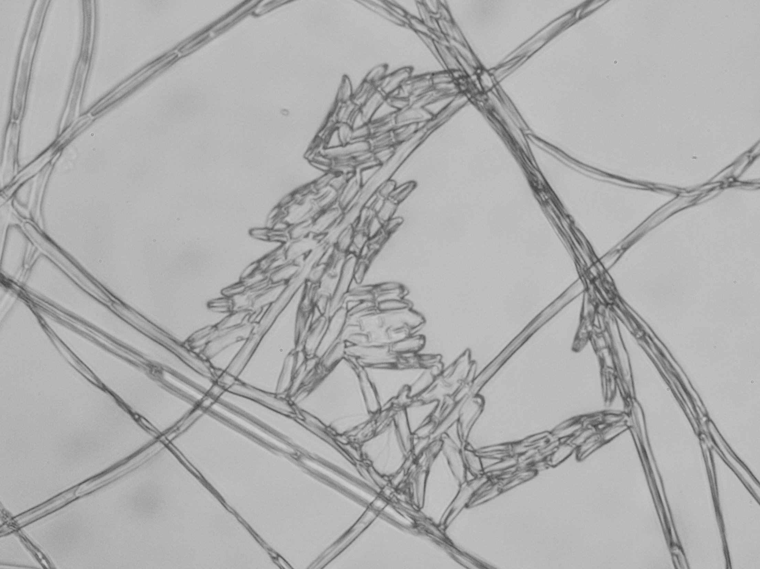



ACKNOWLEDGEMENTS
Game Designers: Dylan Eisenbrandt and Julie Beckstead
Game Development Assistance: Erik Hallstrand, Alexandrite Greenhouse, Mackenzie Rowley, Margarita Washington, and Abbey Shuster
Video Assistance: Abbey Shuster, Libby Shuster, and Sara Wifall
Photos: Zack Berlat, Anna Muhich, and Julie Beckstead
Location of Research Program: Seeds For The Future at Gonzaga University, Spokane WA
Funding: USDA NIFA Agriculture and Food Research Initiative - Research and Extension Experiences for Undergraduates (REEU; 2021-69018-34639 to Julie Beckstead and research collaborators) and the Gonzaga Science Research Program (2022-grant from Gonzaga University to JB).
For Copy of the Game: www.gonzaga.edu/SeedsforTeachers
Information for Seeds For The Future Program:
www.gonzaga.edu/SeedsForTheFuture.

